Slide 1
Crafting Text-Dependent Questions and Prompts
Learning in the Virtual Classroom
Morgan Dunton
ELA Specialist

Slide 2
Live session recorded 3/31/2020
Link to recording
Link to chat record

Slide 3
Agenda
Define qualities of text-dependent questions (TDQ)
Understand why a TDQ approach is critical in the current learning environment
Discuss assessment and scoring practices

Slide 4
If you could create a soundtrack for your life, what songs would you include and why? Discuss at least two songs and explain why you picked them.
What is the essential vocabulary students need to know in order to respond? (academic, topic)
What are the implied assumptions about the student’s prior learning?
What is the success criteria for this prompt? How will students know when they have met the learning expectation?
What feedback might you provide a student?

Slide 5
Text-Dependent Questions and Evidence-Based Responses

Slide 6
Text-dependent Questions
Answered through close reading
Evidence comes from text, not information from outside sources
Understanding beyond basic facts
Not recall!

Slide 7
Which of the following questions require students to read the text closely?
If you were present at the signing of the Declaration of Independence, what would you do?
What are the reasons listed in the preamble for supporting their argument to separate from Great Britain?

Slide 8
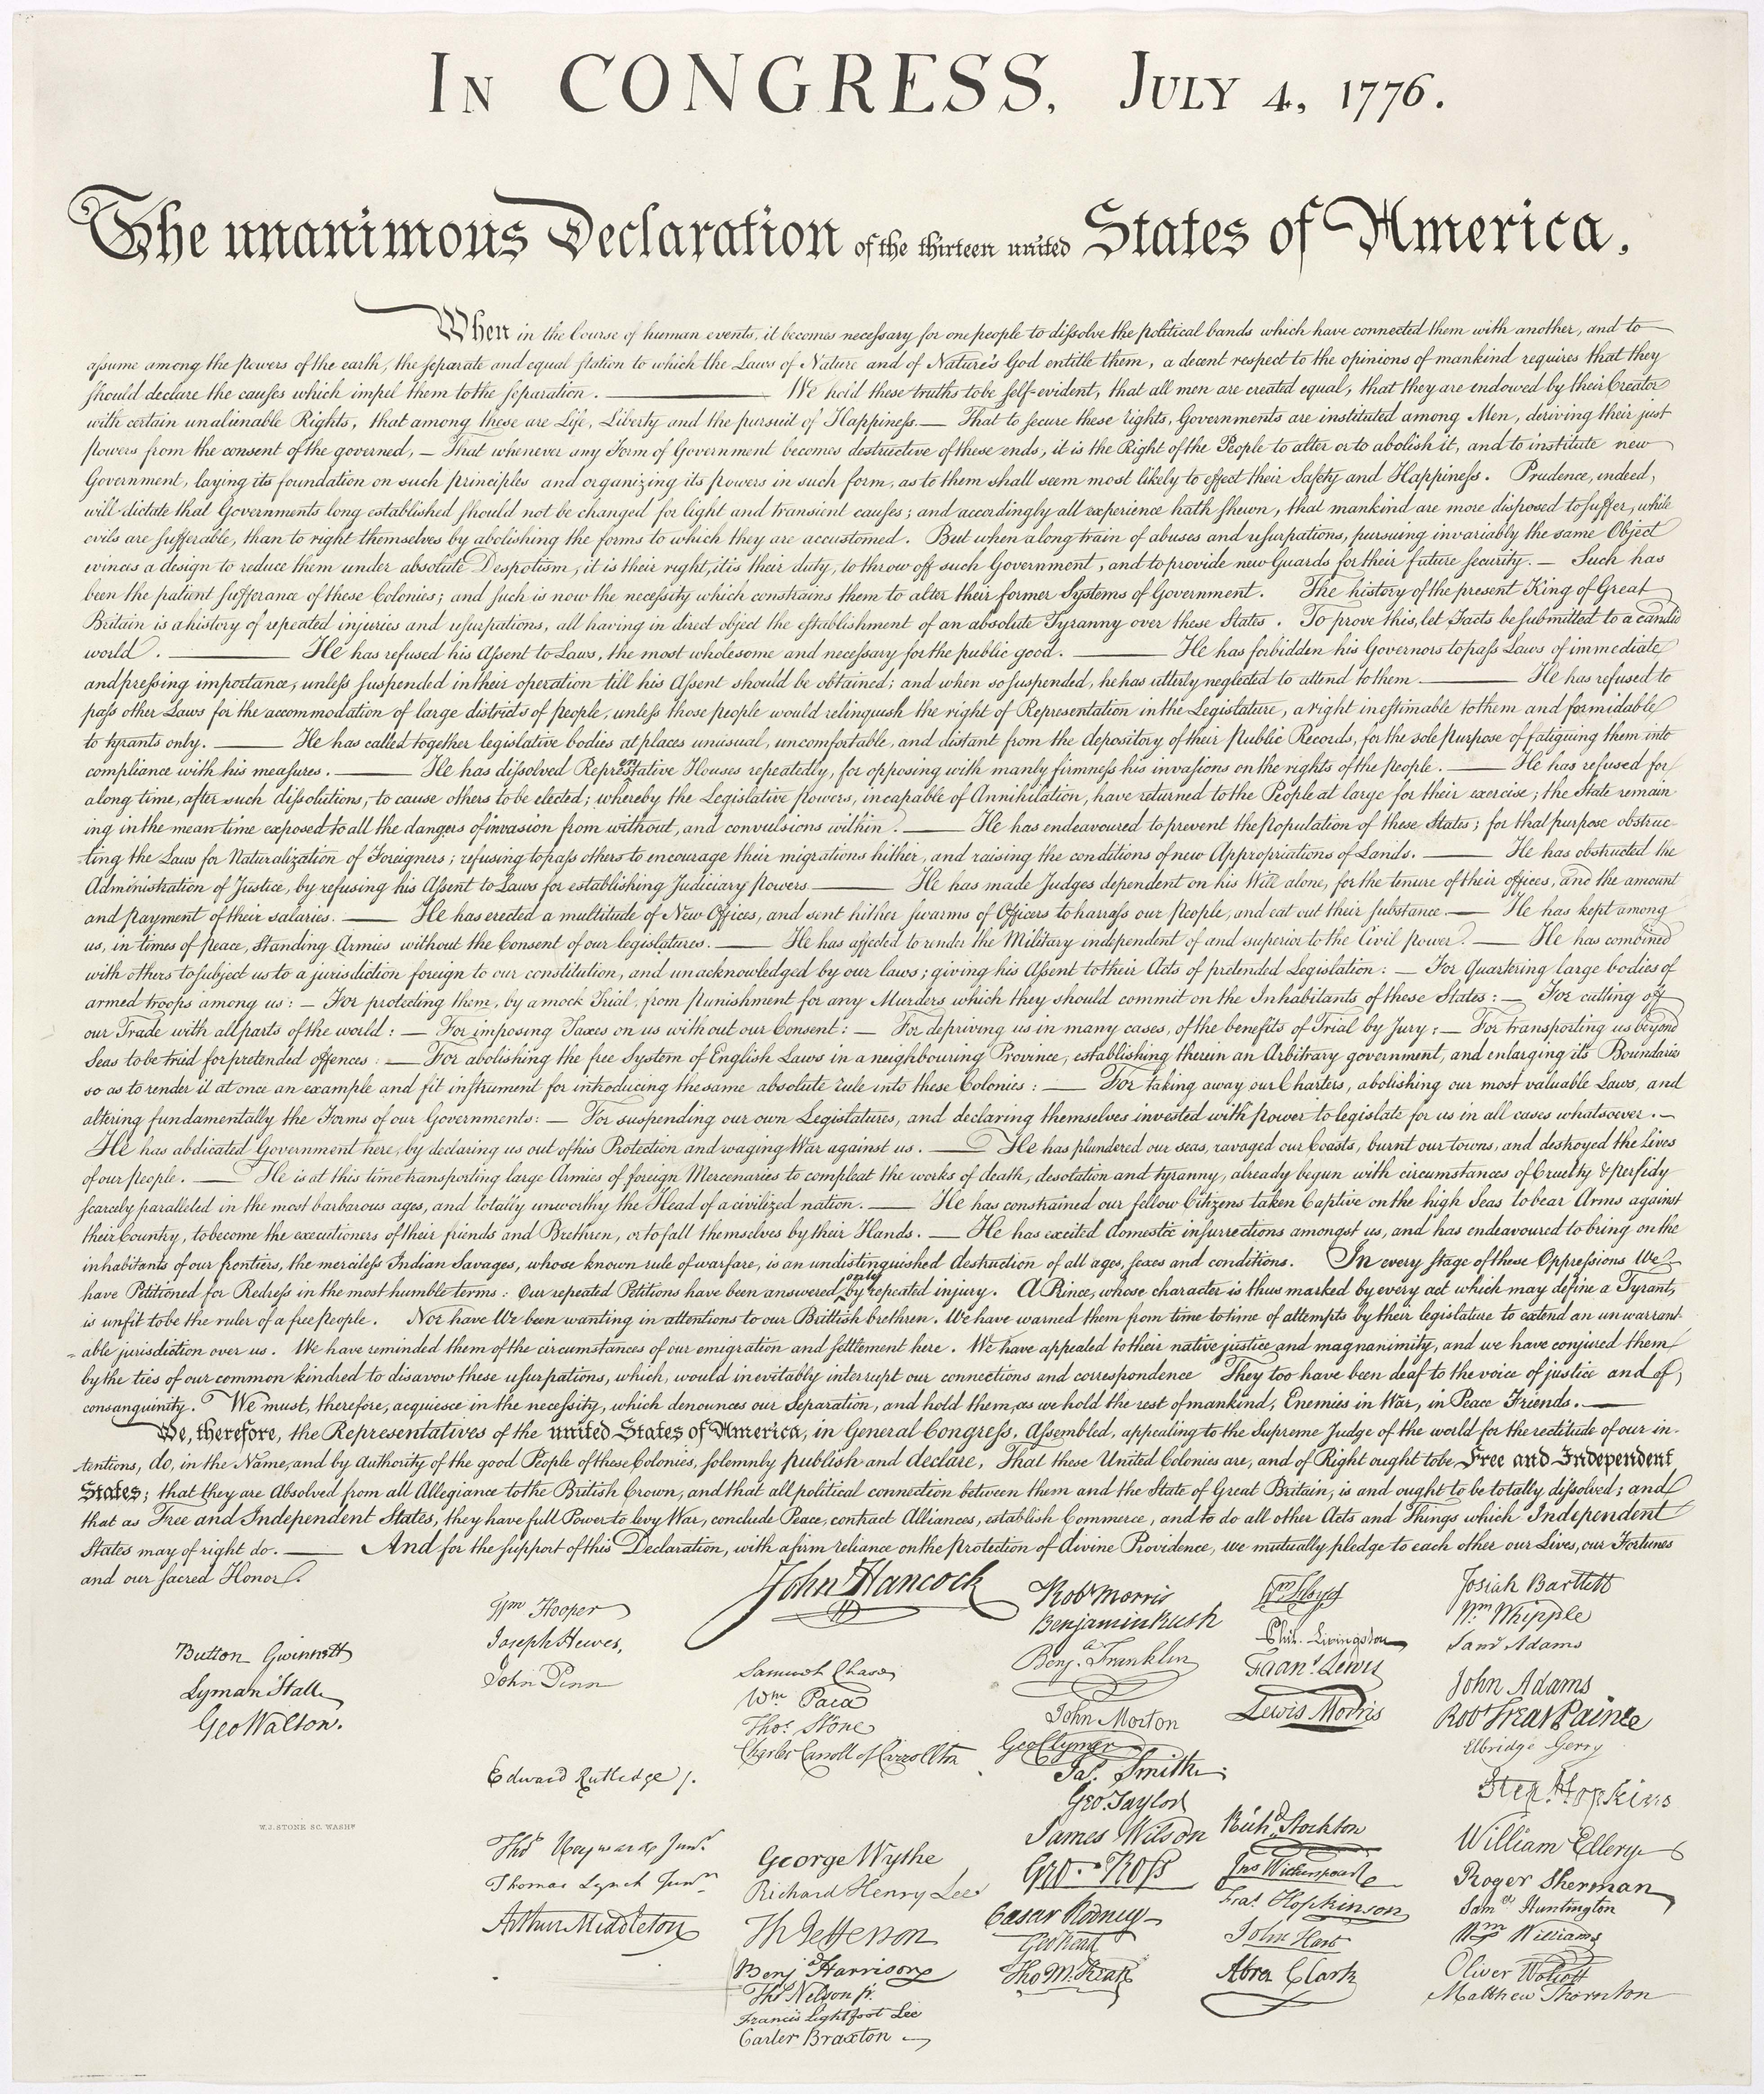
If you were present at the signing of the Declaration of Independence, what would you do?
What are the reasons listed in the preamble for supporting their argument to separate from Great Britain?

Slide 9
The Text Dependent Question or TDQ
Can only be answered by referring explicitly back to the text being read.
Explores the text itself, not the student’s experience.
80-90% of the CCSS reading standards at each grade level require close, critical reading to develop knowledge and insight from a text and to gather evidence.
Notes:
Factoid comes from Achieving the Core site. I postulate that 100% of the reading standards in 6-12 require close reading to demonstrate proficiency.

Slide 10
TDQ
A text-dependent question:
Does not elicit a personal or general response
Does not take the student to the wider world (before getting grounded and familiar with the text)
Does not rely on a student’s prior knowledge to respond
Notes:
This approach challenges the common practice of connecting text-to-self as a priority and text-to-world as a way to get students interested in the text. Engagement develops from a strong sense of purpose but purpose does not mean personal. Purpose may be relative to other learning.

Slide 11
TDQ’s ask students to
Analyze paragraphs on a sentence by sentence basis and sentences on a word by word basis to determine the role played by individual paragraphs, sentences, phrases, or words
Investigate how meaning can be altered by changing key words and why an author may have chosen one word over another
Probe each argument in persuasive text, each idea in informational text, each key detail in literary text, each position in an academic text, and observe how these build to a whole
Notes:
Notice that close reading does not ask DOK 1 level questions for the most part. With a single text, DOK 3 should be the goal. With multiple texts, even with portions of text from different sources, DOK 4 should be the goal of the TDQ.

Slide 12
TDQ’s ask students to
Examine how shifts in the direction of an argument or explanation are achieved and the impact of those shifts
Question why authors choose to begin and end when they do
Note and assess patterns of writing and what they achieve
Consider what the text leaves uncertain or unstated
Notes:
A TDQ requires that the reader approach the text with a writer’s eye.

Slide 13
Choose a Worthy Text(s)
Notes:
A text needs to be worthy of close reading.

Slide 14
Characteristic of a worthy text
Genre or form: generally have specific characteristics. A genre may be presented in various forms i.e. mystery as novel, film, graphic novel, etc.
Notes:
From Fountas and Pinnell: The cont9inuum of Literacy Learning, Grades K-8

Slide 15
Characteristic of a worthy text
Structure: the organizational structure of the text may depend on the norms of the discipline and the form in which it is presented. The structure may also include graphics, illustrations, charts, or other visual features that add to the complexity of the text.

Slide 16
Characteristic of a worthy text
Content: topic of the focus or relative to story structure in fiction. Content may be more challenging when the reader is being introduced to the topic. Some topics may require knowledge of specific vocabulary.

Slide 17
Characteristic of a worthy text
Themes and topics:
Big ideas communicated by the writer; may be concrete or abstract

Slide 18
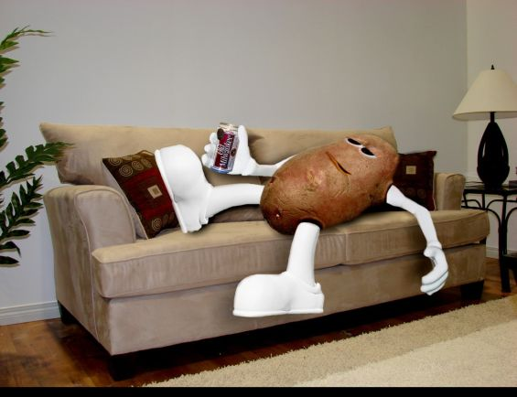
Characteristic of a worthy text
Language and literary features: fiction and nonfiction maintain different uses of language, sometimes blended
I am becoming a couch potato

Slide 19
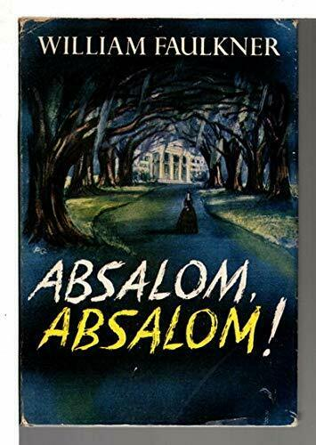
Characteristic of a worthy text
Sentence complexity: a variety of syntax and sentence structures may make the piece more complex
Just exactly like Father if Father had known as much about it the night before I went out there as he did the day after I came back thinking Mad impotent old man who realized at last that there must be some limit even to the capabilities of a demon for doing harm, who must have seen his situation as that of the show girl, the pony, who realizes that the principal tune she prances to comes not from horn and fiddle and drum but from a clock and calendar, must have seen himself as the old wornout cannon which realizes that it can deliver just one more fierce shot and crumble to dust in its own furious blast and recoil, who looked about upon the scene which was still within his scope and compass and saw son gone, vanished, more insuperable to him now than if the son were dead since now (if the son still lived) his name would be different and those to call him by it strangers and whatever dragon’s outcropping of Sutpen blood the son might sow on the body of whatever strange woman would therefore carry on the tradition, accomplish the hereditary evil and harm under another name and upon and among people who will never have heard the right one;

Slide 20
Choose a worthy text
No doubt, you have already done this
Note the particular qualities you want students to notice, note, analyze, and use in responses
Make sure your questions and assignments reflect or capture these qualities
Consider the culminating task that results from reading/viewing
Notes:
We often select a title for specific reasons, then meander away from that reason as we develop lessons.

Slide 21
Then develop text-dependent questions in four phases

Slide 22
Phases of Close Reading
Called a “phase” to reflect the progressive and iterative nature of close reading practices
Each phase aligns to multiple standards across multiple strands
Each phase is a step in the development of grade level reading skills
Each phase can begin anew with a different text

Slide 23
What Does the Text Say?
Literal understanding of the text
Pair with key detail questions
Help to form links between primary ideas and supporting evidence

Slide 24
How Does the Text Work?
Addresses the mechanics of the text
Vocabulary
Text structure
Author’s craft
Syntax
Word choice
Text features

Slide 25
What Does the Text Mean?
Author’s purpose
Explicit, implicit, or subversive?
In argument, examine
Ethos (credibility)
Pathos (emotional appeal)
Logos (logic)
Questions invite making connections to other texts

Slide 26
What Does the Text Inspire You To Do?
Students use the text as a platform for what happens next
Further inquiry
Related reading
Culminating activity

Slide 27
Progression of Text-dependent Questions
Opinions, Arguments,
Intertextual Connections
Inferences
Author’s Purpose
Vocab & Text Structure
Key Details
General Understandings
Whole
Across texts
Entire text
Segments
Paragraph
Sentence
Word
Part

Slide 28
Progression of Text-dependent Questions
Opinions, Arguments,
Intertextual Connections
Inferences
Author’s Purpose
Vocab & Text Structure
Key Details
General Understandings
Whole
Standards
8 & 9
Across texts
3 & 7
Entire text
6
Segments
4 & 5
Paragraph
2
Sentence
Word
1
Part

Slide 29
Develop Text-dependent Questions for Your Books
Do the questions require the reader to return to the text?
Do the questions require the reader to use evidence to support his or her ideas or claims?
Do the questions move from text-explicit to text-implicit knowledge?
Are there questions that require the reader to analyze, evaluate, and create?

Slide 30
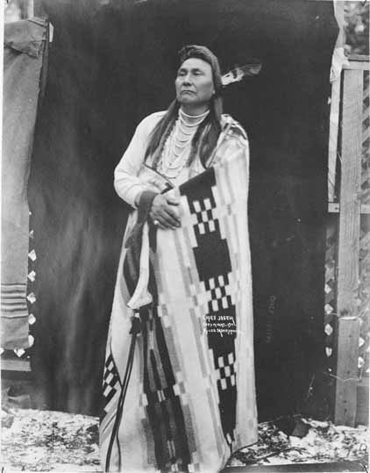
1877

Slide 31
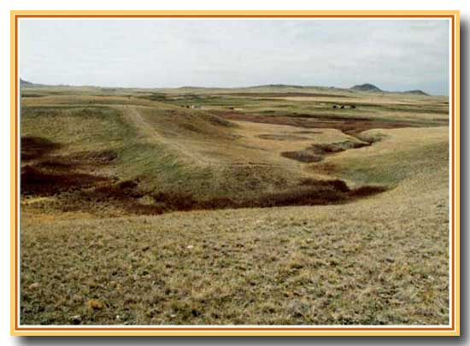
What does the text say? General Understanding
Who is delivering the speech?
What happened?
Notes:
Canyon Creek Battlefield, Bear Paw Mountains, Montana: site of Chief Joseph’s speech.
Background info: In 1863, some Nez Perce chiefs signed a treaty with the US agreeing to surrender their ancestral lands and be moved instead to a reservation in Idaho. Chief Joseph the Elder (Chief Joseph’s father), Chief Looking Glass and Chief Toohulhulsote, as well as others, refused to do so. This lead to an uneasy standoff for 14 years, during which time the non-treaty Nez Perce were allowed to remain. In 1877, the US Army decided to take action to end the standoff. The Nez Perce War was the name given to the U.S. Army's pursuit of the over 800 Nez Perce and an allied band of the Palouse tribe who had fled toward freedom. Initially they had hoped to take refuge with the Crow nation in the Montana Territory, but when the Crow refused to grant them aid, the Nez Perce went north in an attempt to reach asylum with Sioux Chief Sitting Bull and his followers who had fled to Canada in 1876.
For over three months, the Nez Perce outmaneuvered and battled their pursuers traveling 1,170 miles across Oregon, Washington, Idaho, Wyoming, and Montana.
General Howard, leading the opposing cavalry, was impressed with the skill with which the Nez Perce fought, using advance and rear guards, skirmish lines, and field fortifications. Finally, after a devastating five-day battle during freezing weather conditions with no food or blankets, with the major war leaders dead, Joseph formally surrendered to General on October 5, 1877 in the Bear Paw Mountains of the Montana Territory, less than 40 miles south of Canada. (Source: Wikipedia)
The battle is remembered in popular history by the words attributed to Chief Joseph at the formal surrender.

Slide 32
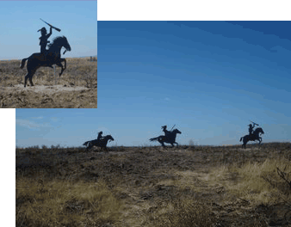
What does the text say? General Understanding
Without yet knowing who Looking Glass and Toohulhulsote are, what can we say about their roles in this decision?
Notes:
Pronunciation: Too hool hool zo the

Slide 33
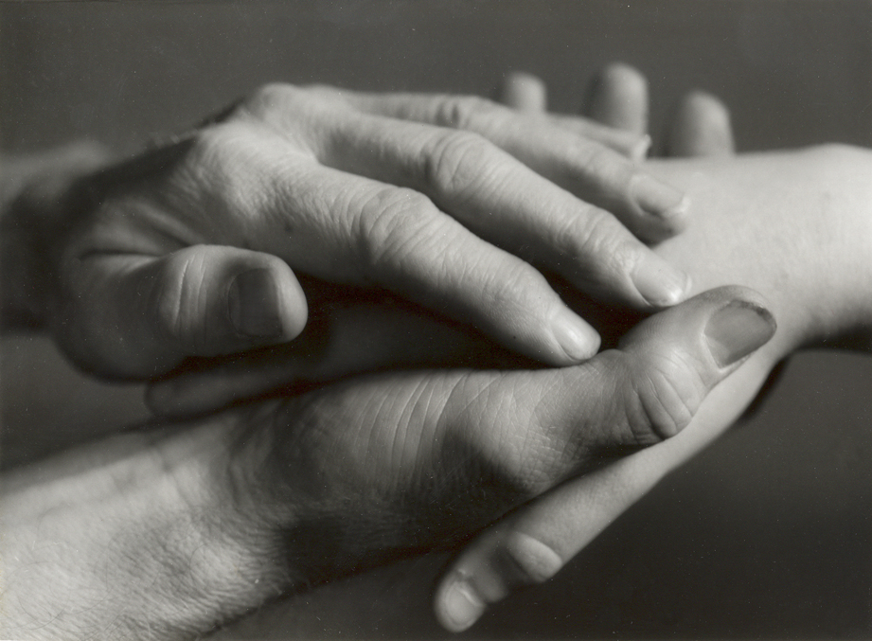
What does the text say? Key Details
What concerns does Chief Joseph have about the health and welfare of his people? How do you know?

Slide 34
Read the speech aloud.
Add pauses, inflections, intonations, and emphasis (prosody) to the text.

Slide 35
How does the text work? Vocabulary
What does Chief Joseph mean when he says, “From where the sun now stands?”

Slide 36
How does the text work? Vocabulary
What is the tone of this speech? What words and phrases support your claim?

Slide 37
How does the text work? Structure
How does the text structure convey Chief Joseph’s mood?

Slide 38
How does the text work? Structure
What is it about the use of the word forever in the last line, “I will fight no more forever” that makes this statement so memorable?

Slide 39
What does the text mean? Inferences
Who is Chief Joseph referring to when he says, “I want to have time to look for my children”? What other parts of the speech support your claim?

Slide 40
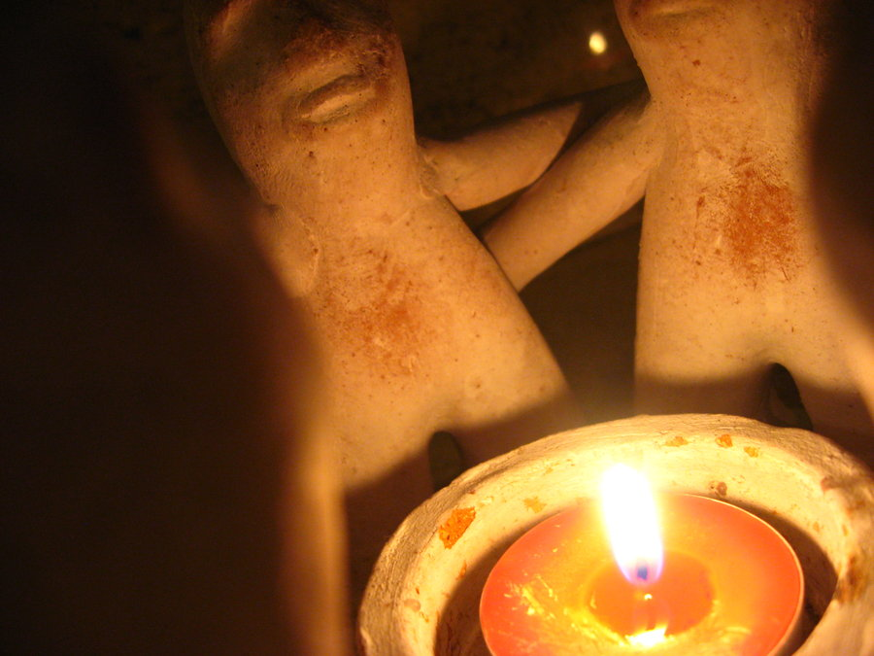
What does the text mean? Intertextual connections
Chief Joseph succeeded his father as leader of the Wallowa band in 1871. Before his death, the father said to his son:

Slide 41
“My son, my body is returning to my mother earth, and my spirit is going very soon to see the Great Spirit Chief. When I am gone, think of your country. You are the chief of these people. They look to you to guide them. Always remember that your father never sold his country. You must stop your ears whenever you are asked to sign a treaty selling your home. A few years more and white men will be all around you. They have their eyes on this land. My son, never forget my dying words. This country holds your father's body. Never sell the bones of your father and your mother.”

Slide 42
Joseph commented "I clasped my father's hand and promised to do as he asked. A man who would not defend his father's grave is worse than a wild beast."

Slide 43
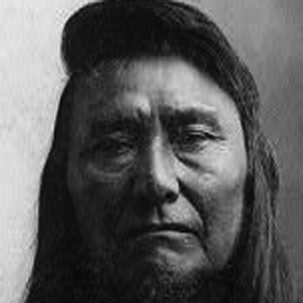
What does the text mean? Intertextual connections
How does this second passage help you to understand the speech?
What inner conflict would Chief Joseph have experienced?
Where do you see evidence of this conflict in the speech?

Slide 44
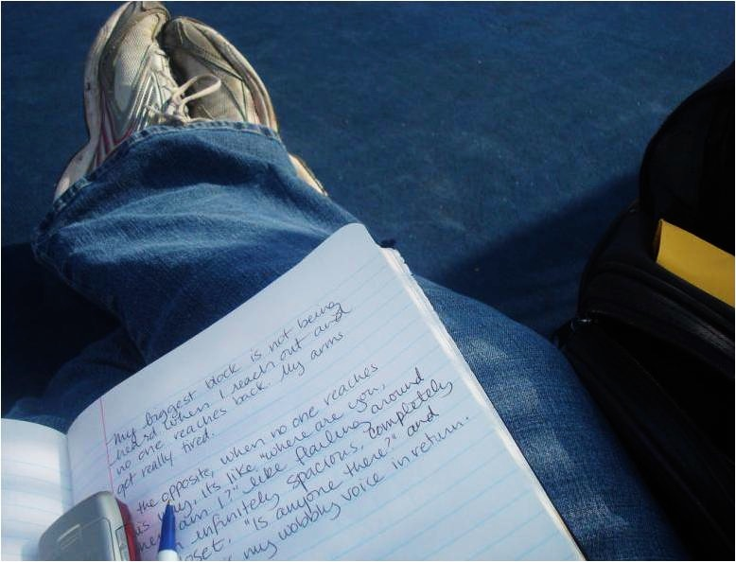
Writing From Sources
What is the role of courage in surrender? After reading and discussing Chief Joseph’s speech “I Will Fight No More Forever,” write an essay that defines courage and explains the courageousness of Chief Joseph’s decision. Support your discussion with evidence from the text. What conclusions can you draw?
Constructed using Task Template 12: www.literacydesigncollaborative.org

Slide 45
If you could create a soundtrack for your life, what songs would you include and why? Discuss at least two songs and explain why you picked them.
What is the essential vocabulary students need to know in order to respond? (academic, topic)
What are the implied assumptions about the student’s prior learning?
What is the success criteria for this prompt? How will students know when they have met the learning expectation?
What feedback might you provide a student?

Slide 46
From Edutopia: PRIORITIZE LONGER, STUDENT-DRIVEN ASSIGNMENTS
Efficiency is key when designing distance learning experiences.
Planning is going to take more time and require a high level of attention to detail.
You will not be able to correct mistakes on the fly or suddenly pivot when kids are disengaged.

Slide 47
From Edutopia: PRIORITIZE LONGER, STUDENT-DRIVEN ASSIGNMENTS
Prioritize longer, student-driven assignments and tasks that buy you time to keep planning future units—and that get your students off the computer.
Focus on building toward long-term projects where students have autonomy and a clear set of checkpoints and deadlines that need to be met.
Create opportunities for students to discuss what they’re learning with their families and include an element of student choice to really build engagement.

Slide 48
Use evidence from the text: film trailer
Write a one sentence summary of the film trailer
What is the purpose of the film?
What language in the trailer suggests or reflects the purpose of the film?
What questions do you expect to be explored and/or answered during the film?

Slide 49
ONE CHILD NATION
EXPLORING CHINA’S ONE CHILD POLICY – visual text
Notes:
Trailer is 2:47

Slide 51
Review your questions and tasks
Determine whether students can respond with evidence from the text at hand.
Focus on getting to a culminating activity that reflects the progression of close reading tasks.
Be patient. Give students time to work.

Slide 52
Get your contact hours
Complete the survey
Answer “yes” to the last question to get your hours
Survey link with contact hours at end: https://forms.gle/KXB7UY4ZrDTuqSew8

